Slide 1
Dual-Stack IPv4 and IPv6 Implementation

Slide 2



HELLO!
TEAM-1:
Tarun Vamsi Krishna Chavatapalli
17A91A04I2
Sree Lasya Lagamsani
17A91A04K5
Rama Krishna Rohith Kankatala
17A91A04M0

Slide 3
Dual-Stack
Dual-stack means that the device is able to run both IPv4 and IPv6 in parallel and allows hosts to simultaneously reach IPv4 and IPv6 content, so it offers a very flexible coexistence strategy.
The dual-stack configured can be implemented on a single interface or multiple interfaces. In this configuration, the devices decides how to send the traffic based on the destination address of the other device.

Slide 4
About the Dual-stack
Benefits of Dual Stack:
Native dual stack does not require any tunnelling mechanism on internal networks.
Both IPv4 and IPv6 run independent of each other.
Needs of Dual Stack:
The evolution of the Internet to IPv6 will directly affect enterprise customers because they will have to communicate with their customers, partners, and suppliers.
In order to ensure business continuity and future growth, all organizations need to carefully plan for coexistence between IPv4 and IPv6.

Slide 5
About the Project
ACOE campus recommended design for scalability and availability. A Multi-Layer switch is used to manage Lab Networks and Cisco 1941 router used to manage different departments on the campus. These departments connect to the internet using the sub-interface concept of the router. NAT has been implemented for internet connectivity. The webserver and ISP act as a medium of internet connectivity in this simulation. Also, HSRP implemented for router redundancy. If any problem happens at the forwarding router, then the entire traffic would be automatically routed to the backup router and the user will still have connectivity to other departments and to the Internet without any downtime. And when the forwarding router comes online, the traffic again will be routed to forwarding router making backup router as standby. Though it has been implemented at a basic level, the topics, technologies, and protocols we have used in this scenario can be altered to design and recommend even better topology for campus networks to reduce connectivity and bandwidth problems.

Slide 6
Technologies and Protocols Used
"VLAN" - To completely reduce broadcasts in networks thus by tuning up network performance.
"Multi-Layer Switch" - To avoid purchasing of expensive routers to route between multiple networks.
"Sub-Interfaces" - To avoid using multiple routers to route the traffic between different departments.
"HSRP" - To make redundant links so that even if one router is down due to any reason, still the users will have connectivity to the Internet and other network resources.
"Trunk Links" - To avoid using multiple cables to run between different VLANs that will make a mess with cabling infrastructure. In simple means, complete reduction of cabling infrastructure.

Slide 7
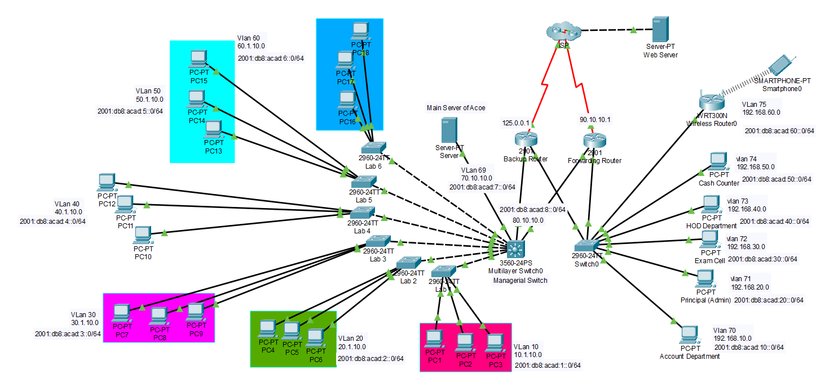
Network

Slide 8
Configurations

Slide 9
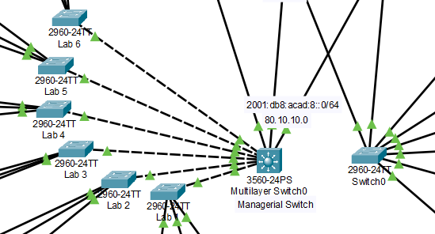
VLAN
A Virtual LAN (VLAN) is any broadcast domain that is partitioned and isolated in a computer network at the data link layer (OSI layer 2).
To connect both switches in same network assign the ports connecting the switches in the same VLAN in both the switches. To get support for IPv6 in switches 2906, cisco IOS must be updated to version 15.

Slide 10
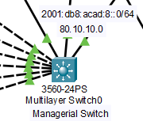
Multilayer-Switch
A multilayer switch can perform the functions of a switch as well as that of a router at incredibly fast speeds.
Dynamic routing can be configured in this device.
To enable dual-stack in multilayer switch and traditional switch SDM commands are used.
Then configuration of interfaces support assigning of both IPv4 and IPv6 address.
It is a network device that has the ability to operate at higher layers of the OSI reference model, unlike the Data Link Layer (DLL) traditionally used by switches.

Slide 11
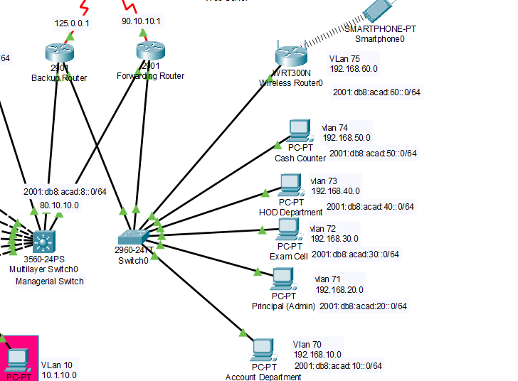
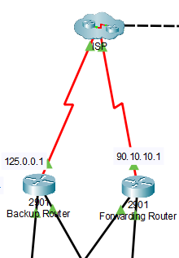
Router on a stick
Router is configured in such a way, where sub-interfaces are used in router and trunking is used in a switch to reduce the connecting cables
Dynamic Routing and Default Routing

Slide 12
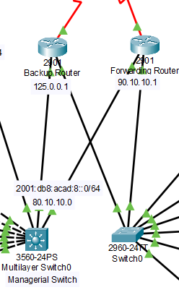
Hot Standby Routing Protocol
It allows host computers on the Internet to use multiple routers that act as a single virtual router, maintaining connectivity even if the first- hop router fails, because other routers are on “hot standby”.

Slide 13


Thank You!
Mentor : Md. Shaifu Zama

